Slide 1


Apprenticeships unmasked.
Are they right for my business?
Adrian O’Neill. Skills Specialist. York and North Yorkshire Growth Hub. Part of the Combined Authority.
Notes:
1

Slide 2

Content for today:
1: What are Apprenticeships?
2: Who can be an Apprentice?
3: Types of Apprenticeships and how do I find the right one?
4: How are they paid for?
5: Will it help my business grow?
6: What else do I need to consider?
7: What’s the best process to follow?
8: Is there any support?
9: Q&A

Slide 3

1) What are Apprenticeships?
It's not just for plumbers!
It mixes full time practical employment, aka a ‘real job’, alongside high quality nationally recognised training and qualifications that relates to that job. 20 % of the time will be spent training, meaning 80% of the time will be spent directly working.
Minimum of 1 year in length and up to 5 years depending in the level.
20XX
Contoso business plan
3
Notes:
3

Slide 4


2) Who can be an apprentice?
Basically anyone!
Min age is 16. No maximum!
Need to be living in the UK and not in full time education.
They can be a new employee, or an existing member if staff.

Slide 5


3) Types of apprenticeships and how do I find the right one?
Level 2 – GSCE equivalent
Level 3 – A Level
Level 4 – HNC
Level 5 – HND
Level 6 - Degree
Level 7- Masters
First decide on the role or skills gap you’d like to fill.
Then find the right Standard based on that.
Search the official database.
If in doubt, just ask!
https://findapprenticeshiptraining.apprenticeships.education.gov.uk/courses

Slide 6

4) How are they paid for?
Is your annual wage bill over £3million?
If your annual wage bill is less than £3million then………
Then you pay into the apprenticeship levy, and you don’t have to pay anything extra, other than the apprentice wage.
Its 100% funded provided that…..(other than the apprentice wage.)
The apprentice is under 21 when the training commences, or….
22 and 24 years-old who have an Education, Health and Care (EHC) plan and / or have been in the care of their local authority
For everybody else you have to pay just 5% of the training cost!
For example, a Level 3 Business Admin apprentice standard costs £5000. 95% is fully funded meaning a cost to the business is £250. Other than the apprentice wage!

Slide 7


5) Will it help my business grow?
Apprentices are a long-term investment, not a short-term fix
Successful programmes use Apprenticeships as an excellent way of both recruiting new talent and improving staff retention.
They can be extremely useful in filling niche or hard to find skills gaps, also making recruitment easier.
They make long term succession planning much easier.
The individuals grow alongside the business
Successful programmes will encourage innovation and problem solving.

Slide 8

6. What else do I need to consider?
How the apprenticeship will be delivered? For example, a day a week in a college or entirely virtual?
Will need to assign a mentor
If the apprentice is young, they will need pastoral care.
How will they fit within the organisation or team?
They will need time to work on their apprenticeship.

Slide 9


7. What’s the best process to follow?
1. Find your skills need or gap
2.Find the right ‘Standard’ that best matches
3. Find the right provider and delivery model.
4. Finally, do the recruitment part last. (Partner with your provider to help you)

Slide 10

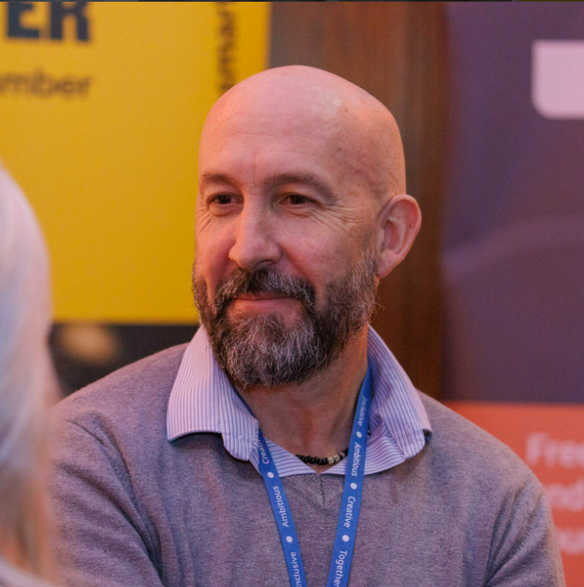
8. Is there any Support?
Based in York or North Yorkshire?
https://www.gov.uk/employing-an-apprentice
https://www.gov.uk/employing-an-apprentice/get-help

Slide 11


Thank you
York and North Yorkshire Combined Authority
Q&A
20XX
11
Notes:
11

